Slide 1




Next Gen Employability Program
Full Stack Web Development with AI Tools
Team Details – NG_CP_Team_387
Name: Krishna Sharma
Name: Ojass Bhardwaj
Name: Jaanhavi Singh
Name: Aamir Sohail
Name: Raghav Kalra
College: Inderprastha Engineering College, Ghaziabad

Slide 2

The content is curated from online/offline resources and used for educational purpose only.
Notes:
Speaker would be briefing the students that this content has been prepared for the educational purpose only and is referred from multiple sites which are cited in the last.​​
---------------------------------------------------​​
A disclaimer is a statement or notice that is intended to clarify, limit, or provide information about the scope, limitations, or potential risks associated with certain actions, information, products, services, or content. ​​
​​
​

Slide 3

Project Title
AI-powered price and review comparison
Notes:
In this slide speaker will be introducing the program and its outcomes. The speaker will introduce himself in brief

Slide 4

Table of Contents
Introduction
Problem Statement
Proposed Solution
Key features
Technology Stack
System flowchart
Core Modules
Security measures
References
Notes:
This slide, The speaker will talk about the content that we will be covering in this session as follows:
Introduction
Importance of UI/UX in industry
History and Definitions of UI and UX
Key Differences between UI/UX
Use Cases
Significance in Web Development
Use Cases
Visual Design Principles
Design process
Color theory and psychology
Typography and readability
Layout and Spacing
Responsive design basics
Usability and Accessibility
Usability Aspects
Web Content Accessibility Guidelines (WCAG)
Inclusive design practices
Consistency
User Experience
User-Centered Design
User research methods
Interactive Elements and Feedback
Mini Case Study
Discussing a popular UI/UX design
Hands-On
Introduction to Figma for UI/UX design

Slide 5
Introduction
In today’s digital shopping environment, users are presented with multiple e-commerce platforms offering the same product at different prices, discounts, and ratings.
This creates confusion and makes it difficult for users to decide where and when to buy a product.
Most existing platforms only display raw price data and reviews, leaving the decision-making burden on the user.
ShopSync is developed to solve this problem by acting as a decision-support system. It collects visible market data, analyzes it logically, and explains it clearly using AI, helping users make confident purchasing decisions.
Notes:
This slide, The speaker will talk about the content that we will be covering in this session as follows:
Introduction
Importance of UI/UX in industry
History and Definitions of UI and UX
Key Differences between UI/UX
Use Cases
Significance in Web Development
Use Cases
Visual Design Principles
Design process
Color theory and psychology
Typography and readability
Layout and Spacing
Responsive design basics
Usability and Accessibility
Usability Aspects
Web Content Accessibility Guidelines (WCAG)
Inclusive design practices
Consistency
User Experience
User-Centered Design
User research methods
Interactive Elements and Feedback
Mini Case Study
Discussing a popular UI/UX design
Hands-On
Introduction to Figma for UI/UX design

Slide 6
Problem Statement
Online shoppers face several challenges:
Prices of the same product vary across platforms
No clear indication of whether a deal is actually good
Fake, biased, or confusing reviews
No visibility into past price trends
Manual comparison is time-consuming and inefficient
Limitations of Existing Solutions
Show only raw data, not insights
Often biased or sponsored
No AI-based explanation
Lack of decision guidance
Notes:
This slide, The speaker will talk about the content that we will be covering in this session as follows:
Introduction
Importance of UI/UX in industry
History and Definitions of UI and UX
Key Differences between UI/UX
Use Cases
Significance in Web Development
Use Cases
Visual Design Principles
Design process
Color theory and psychology
Typography and readability
Layout and Spacing
Responsive design basics
Usability and Accessibility
Usability Aspects
Web Content Accessibility Guidelines (WCAG)
Inclusive design practices
Consistency
User Experience
User-Centered Design
User research methods
Interactive Elements and Feedback
Mini Case Study
Discussing a popular UI/UX design
Hands-On
Introduction to Figma for UI/UX design

Slide 7
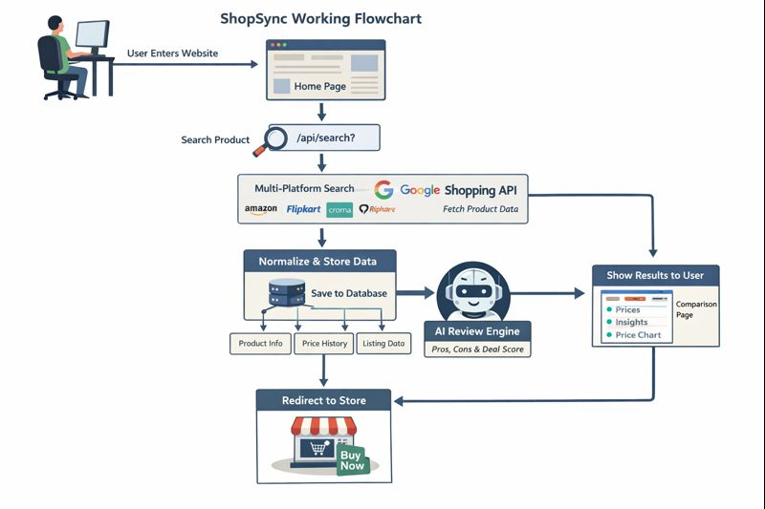
Proposed Solution
ShopSync is an AI-powered price and decision intelligence platform that:
Observes real-time market data using trusted APIs
Compares prices across reliable platforms
Uses AI to explain numerical price signals
Tracks historical prices to show trends
Redirects users using affiliate APIs for ethical monetization
Notes:
This slide, The speaker will talk about the content that we will be covering in this session as follows:
Introduction
Importance of UI/UX in industry
History and Definitions of UI and UX
Key Differences between UI/UX
Use Cases
Significance in Web Development
Use Cases
Visual Design Principles
Design process
Color theory and psychology
Typography and readability
Layout and Spacing
Responsive design basics
Usability and Accessibility
Usability Aspects
Web Content Accessibility Guidelines (WCAG)
Inclusive design practices
Consistency
User Experience
User-Centered Design
User research methods
Interactive Elements and Feedback
Mini Case Study
Discussing a popular UI/UX design
Hands-On
Introduction to Figma for UI/UX design

Slide 8
Key Features
🔹 Multi-platform price comparison
🔹 AI-generated pros, cons, and verdict
🔹 Deal score and best-time-to-buy suggestion
🔹 Price history tracking and visualization
🔹 Real-time data using APIs (no scraping)
🔹 Affiliate API-based redirection
🔹 Platform-neutral and unbiased results
🔹 Secure user authentication
🔹 Graceful degradation when data is unavailable
Notes:
This slide, The speaker will talk about the content that we will be covering in this session as follows:
Introduction
Importance of UI/UX in industry
History and Definitions of UI and UX
Key Differences between UI/UX
Use Cases
Significance in Web Development
Use Cases
Visual Design Principles
Design process
Color theory and psychology
Typography and readability
Layout and Spacing
Responsive design basics
Usability and Accessibility
Usability Aspects
Web Content Accessibility Guidelines (WCAG)
Inclusive design practices
Consistency
User Experience
User-Centered Design
User research methods
Interactive Elements and Feedback
Mini Case Study
Discussing a popular UI/UX design
Hands-On
Introduction to Figma for UI/UX design

Slide 9
Technology Used
Frontend
HTML – Page structure
CSS – Styling and responsiveness
JavaScript – Dynamic UI and API communication
Backend
Python – Core programming language
Django – Backend framework
Django REST APIs – Client-server communication
Database
SQLite (Django ORM) – Stores product data, prices, and history
APIs & AI
Google Shopping API (SerpAPI) – Market price data
OpenAI API – AI-based explanation of numerical data
Affiliate APIs – Secure redirection and monetization
Notes:
This slide, The speaker will talk about the content that we will be covering in this session as follows:
Introduction
Importance of UI/UX in industry
History and Definitions of UI and UX
Key Differences between UI/UX
Use Cases
Significance in Web Development
Use Cases
Visual Design Principles
Design process
Color theory and psychology
Typography and readability
Layout and Spacing
Responsive design basics
Usability and Accessibility
Usability Aspects
Web Content Accessibility Guidelines (WCAG)
Inclusive design practices
Consistency
User Experience
User-Centered Design
User research methods
Interactive Elements and Feedback
Mini Case Study
Discussing a popular UI/UX design
Hands-On
Introduction to Figma for UI/UX design

Slide 10
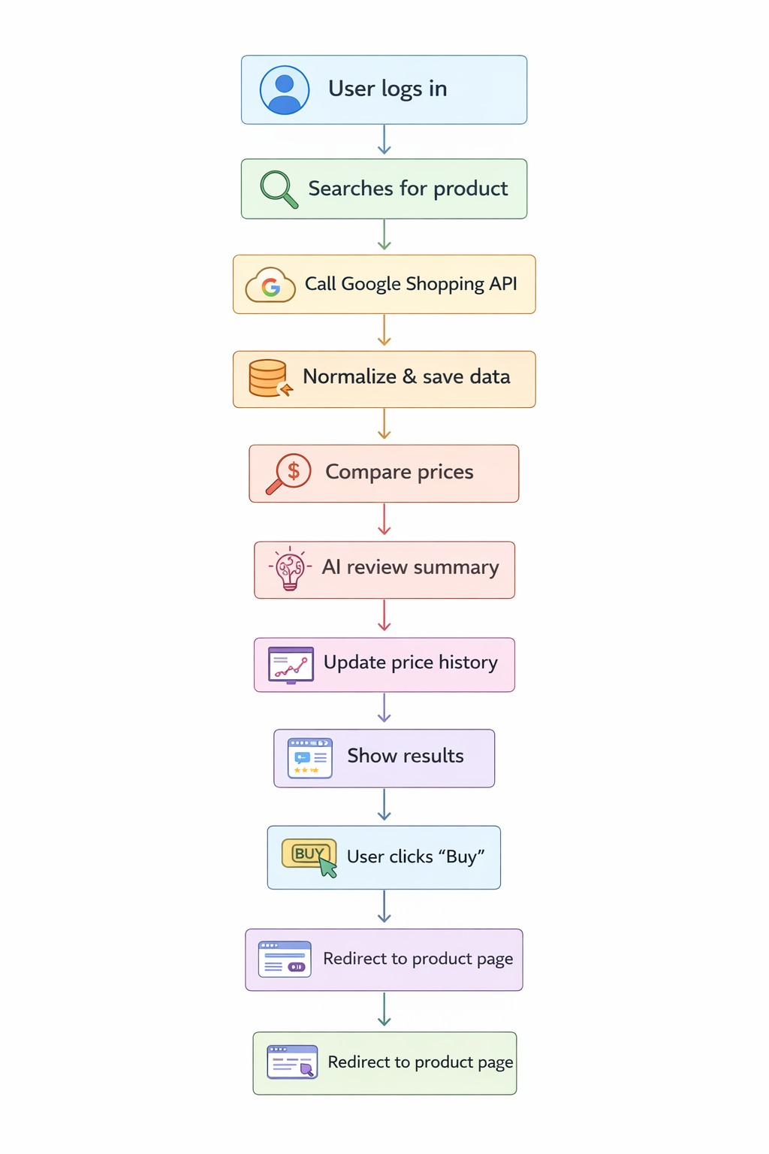
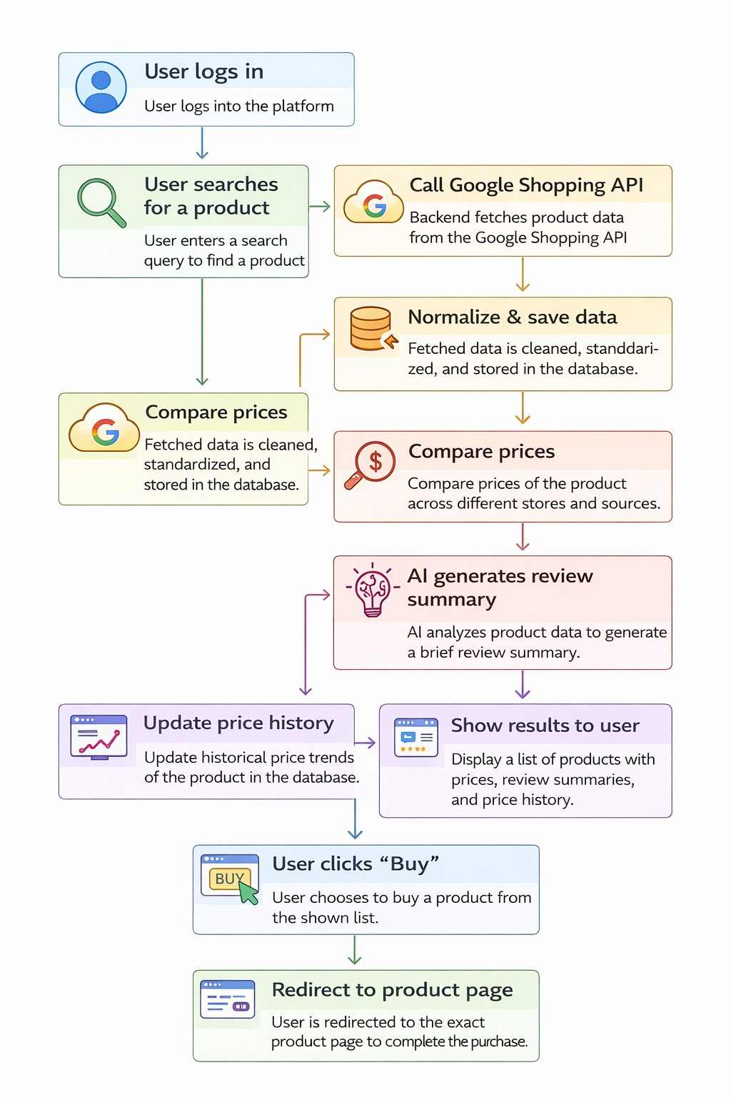
Project Flow
Notes:
This slide, The speaker will talk about the content that we will be covering in this session as follows:
Introduction
Importance of UI/UX in industry
History and Definitions of UI and UX
Key Differences between UI/UX
Use Cases
Significance in Web Development
Use Cases
Visual Design Principles
Design process
Color theory and psychology
Typography and readability
Layout and Spacing
Responsive design basics
Usability and Accessibility
Usability Aspects
Web Content Accessibility Guidelines (WCAG)
Inclusive design practices
Consistency
User Experience
User-Centered Design
User research methods
Interactive Elements and Feedback
Mini Case Study
Discussing a popular UI/UX design
Hands-On
Introduction to Figma for UI/UX design

Slide 11
Core Modules
AI Decision Intelligence Module
Analyzes price spread, seller count, and ratings
Generates deal score, buy/wait suggestion, and AI insights
Price Comparison Module
Displays platform-wise price comparison
Highlights price differences and best offers
Price Trend Analysis Module
Visualizes historical price changes using charts
Supports informed buy-now or wait decisions
Affiliate Redirection Module
Redirects users securely to official e-commerce platforms
Enables ethical and unbiased monetization
Price Alert Module
Allows users to set price-drop alerts
Improves engagement and user convenience
Admin Management Module
Manages products, prices, and AI insights
Ensures data accuracy and system control
User Authentication Module
Manages user login, signup, logout, and sessions
Ensures secure and personalized access
Product Search Module
Accepts user search queries
Initiates multi-platform product search
Market Data Collection Module (SerpAPI)
Fetches real-time product prices and ratings from Google Shopping
Provides unbiased market visibility
Data Normalization & Aggregation Module
Cleans and standardizes price data
Groups products and aggregates platform listings
Product & Price Management Module
Stores products, platforms, and listings
Maintains historical price data
Notes:
This slide, The speaker will talk about the content that we will be covering in this session as follows:
Introduction
Importance of UI/UX in industry
History and Definitions of UI and UX
Key Differences between UI/UX
Use Cases
Significance in Web Development
Use Cases
Visual Design Principles
Design process
Color theory and psychology
Typography and readability
Layout and Spacing
Responsive design basics
Usability and Accessibility
Usability Aspects
Web Content Accessibility Guidelines (WCAG)
Inclusive design practices
Consistency
User Experience
User-Centered Design
User research methods
Interactive Elements and Feedback
Mini Case Study
Discussing a popular UI/UX design
Hands-On
Introduction to Figma for UI/UX design

Slide 12
Security Measures
Django authentication system
CSRF protection
Secure session handling
No web scraping (API-based access only)
Controlled API usage
Graceful degradation to prevent system failure
Notes:
This slide, The speaker will talk about the content that we will be covering in this session as follows:
Introduction
Importance of UI/UX in industry
History and Definitions of UI and UX
Key Differences between UI/UX
Use Cases
Significance in Web Development
Use Cases
Visual Design Principles
Design process
Color theory and psychology
Typography and readability
Layout and Spacing
Responsive design basics
Usability and Accessibility
Usability Aspects
Web Content Accessibility Guidelines (WCAG)
Inclusive design practices
Consistency
User Experience
User-Centered Design
User research methods
Interactive Elements and Feedback
Mini Case Study
Discussing a popular UI/UX design
Hands-On
Introduction to Figma for UI/UX design

Slide 13
References
Django Documentation https://docs.djangoproject.com/
Google Shopping / SERP API https://serpapi.com/
OpenAI Documentation https://platform.openai.com/docs
Python Documentation https://docs.python.org/
Notes:
This slide, The speaker will talk about the content that we will be covering in this session as follows:
Introduction
Importance of UI/UX in industry
History and Definitions of UI and UX
Key Differences between UI/UX
Use Cases
Significance in Web Development
Use Cases
Visual Design Principles
Design process
Color theory and psychology
Typography and readability
Layout and Spacing
Responsive design basics
Usability and Accessibility
Usability Aspects
Web Content Accessibility Guidelines (WCAG)
Inclusive design practices
Consistency
User Experience
User-Centered Design
User research methods
Interactive Elements and Feedback
Mini Case Study
Discussing a popular UI/UX design
Hands-On
Introduction to Figma for UI/UX design

